Slide 1

Predicting H-1B Visa Petitions
Instructor: Dr. Michael Luvalle
Group Members: Sai Mounica Pothuru(sp1912)
Nikhil Neroor(nn323)
Tathagata Dutta(td425)
Chaitanya Sharma Domudala(cd817)
Course: STATS 581

Slide 2
Outline
Introduction
Dataset
Data Exploration
Observations
Predicting The Petitions
Conclusion

Slide 3
Introduction
Everyone wants a life in the United States of America. Getting an H1B Visa is an essential part of that.
The H1B visa is a category of temporary, non-immigrant foreigners employed in the country. For a foreign national to get this visa, he/she must be offered a job and then the employing company submits a petition to the Us immigration department which may or may not be accepted.
Therein lies the question. How do we tell whether or not our H1B visa application will be accepted? What factors contribute most to it being accepted or rejected?
These are some issues that we will try to address with this system.
It would be beneficial for us data scientists to learn about various statistics for our job role. Therefore, we conducted some data exploration for the specific job role: Data Scientist

Slide 4
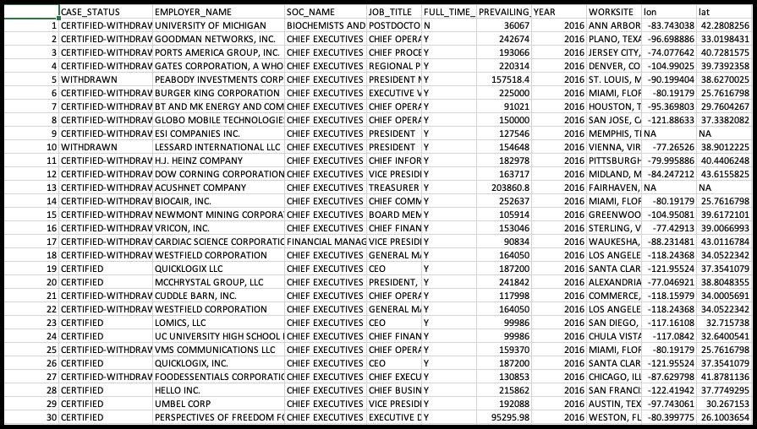
Dataset
The dataset being used for this project is H1B Visas from Kaggle and is a time-series data.
It contains 5 years of H-1B request information from 2011 to 2016, with around 3 million records.
Link to the dataset: https://www.kaggle.com/nsharan/h-1b-visa

Slide 5
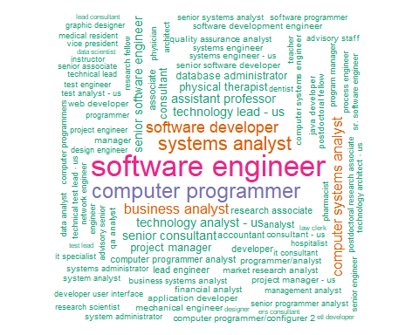
Data Exploration
The data set comprises of 3 million records of cases petitioned for H1-B Visas.
There are diverse people who applied with various job titles .
A word cloud is generated to look at the most prevalent jobs.
From the cloud, we can observe that
Software Engineer is the most demanded job for H1-B,
followed by Computer Programmers, System Analysts, Software Developers and Business Analysts.

Slide 6
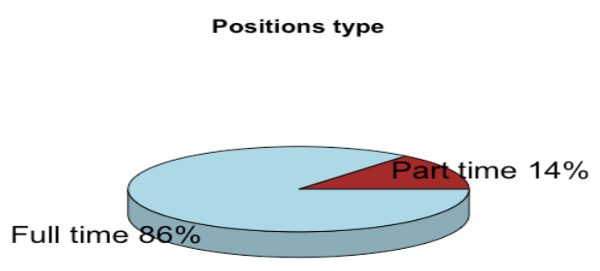
Data Exploration (cont'd)
We checked which position that obtained most H1-B’s.
From the pie chart, we can conclude that
86% are full time positions and
14% are part time positions.

Slide 7
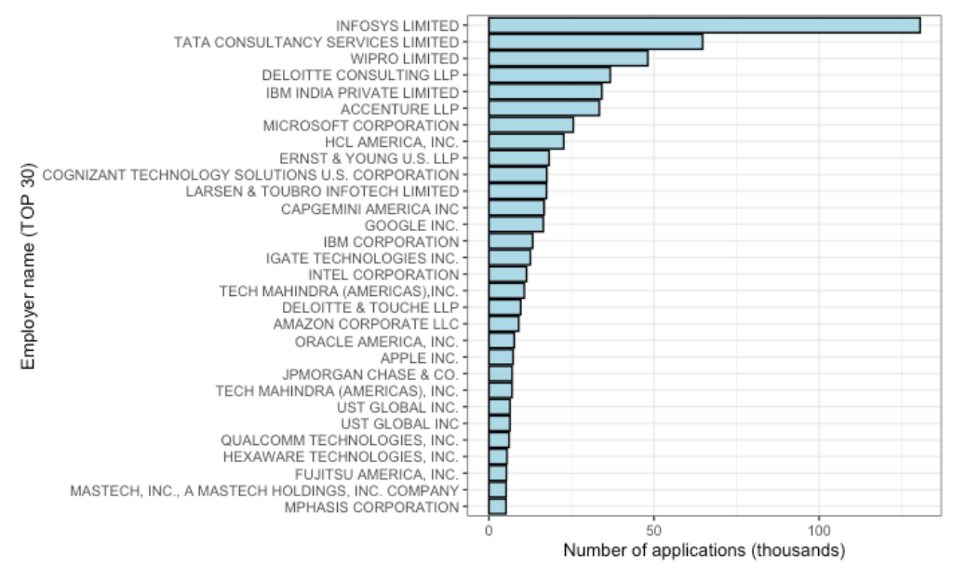
Data Exploration (cont'd)
Here we observe that:
Infosys has submitted highest H1B Visa Applications
Top 5 Companies that submit most H1B Visa Applications are companies based in India associated with software /IT services.

Slide 8
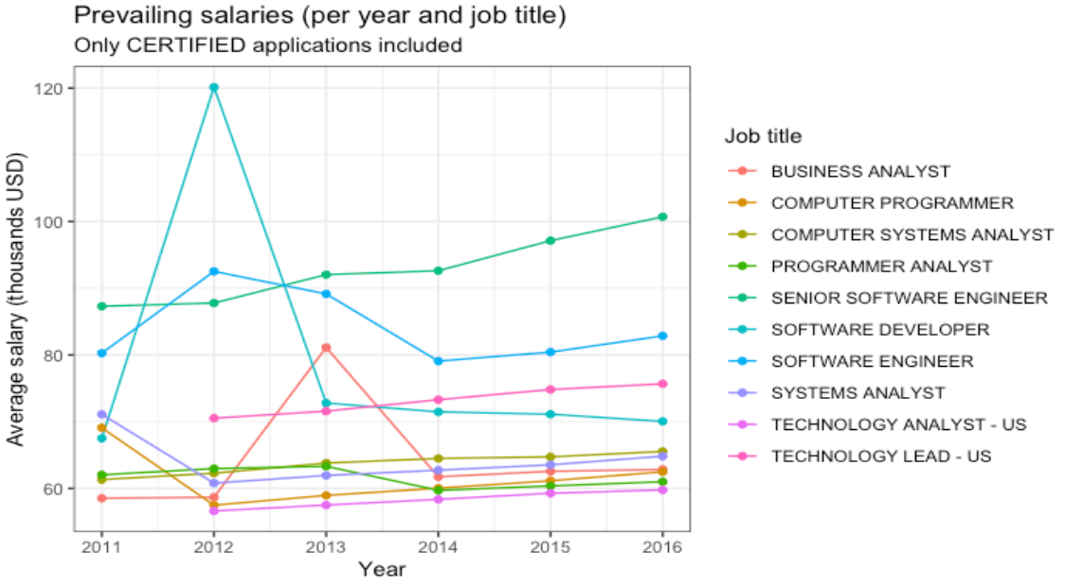
Data Exploration (cont'd)
With the most prevalent jobs obtained, the analysis is done to look at the range of salaries they offered.
Senior Software Engineer maintained the ranking offering the highest salary compared to other jobs.
Computer Programmer and Software Developer showed the most variance during the time.

Slide 9
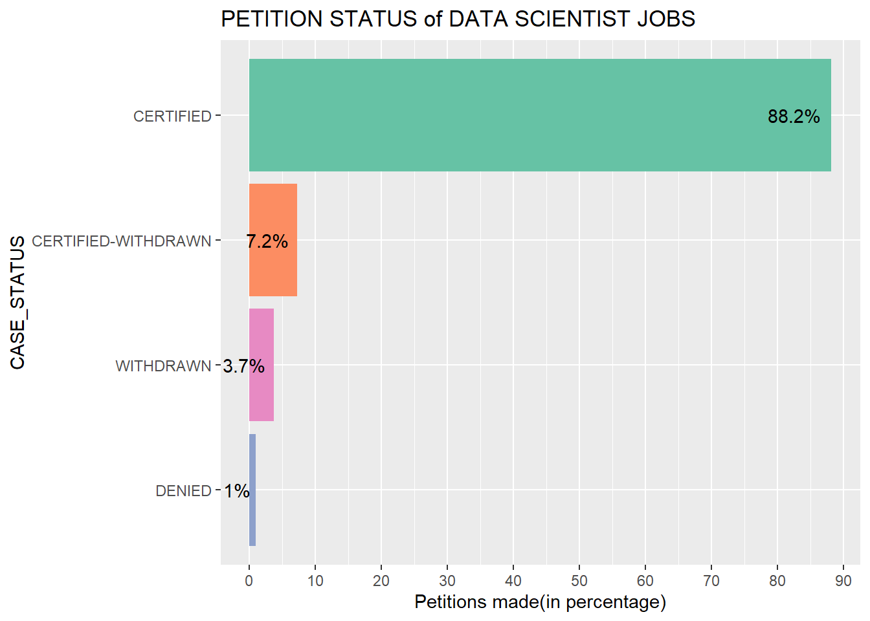
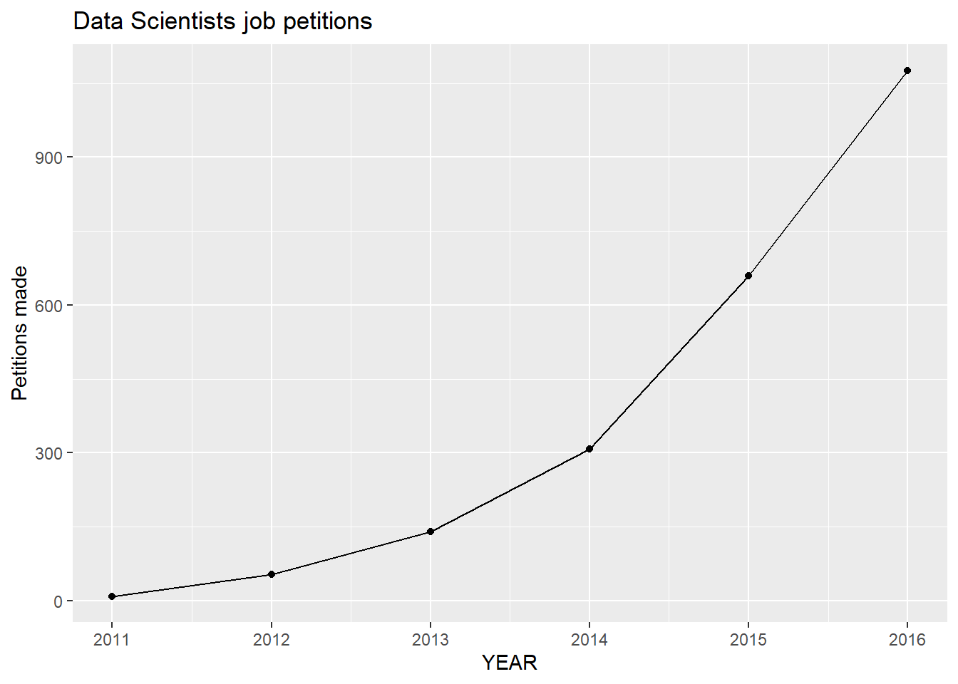
Data Exploration (cont'd)
The following plots show the various scenarios of H1-B petition status under Data Scientist role.
Following observations were made:
Most petitions get certified
There is a steady growth in the number of petitions per year

Slide 10
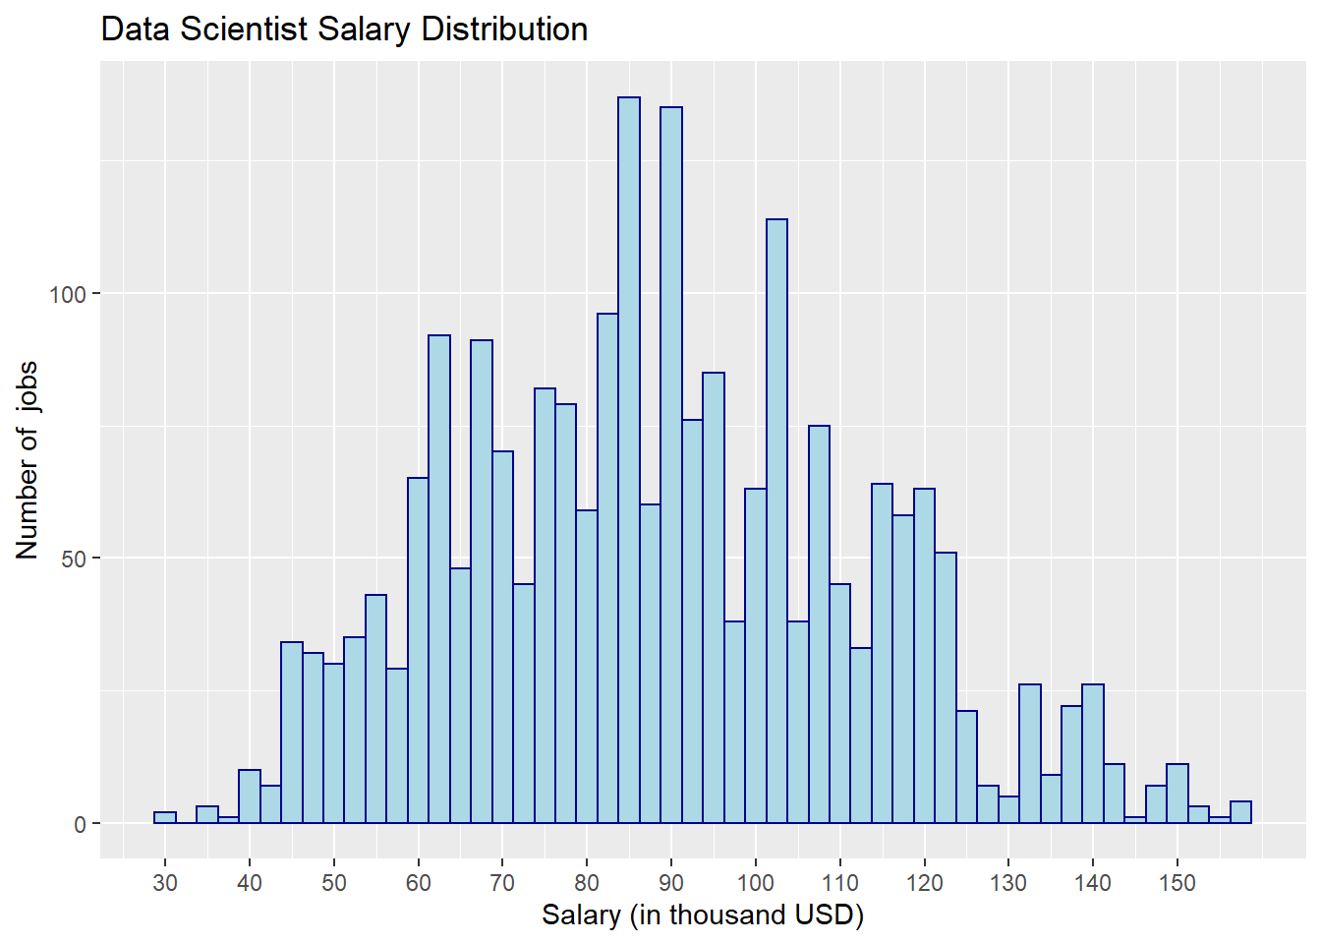
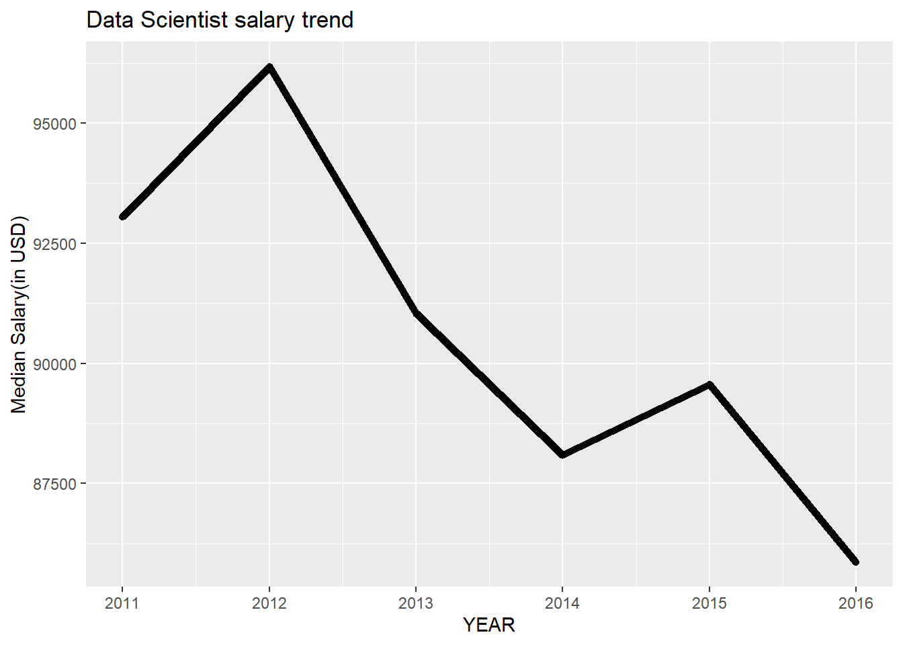
Data Exploration (cont'd)
Continuing with the various scenarios of H1-B petition status under Data Scientist role.
Following observations were made:
Salaries are almost normally distributed.
There is a downward trend of salary for data scientists.

Slide 11
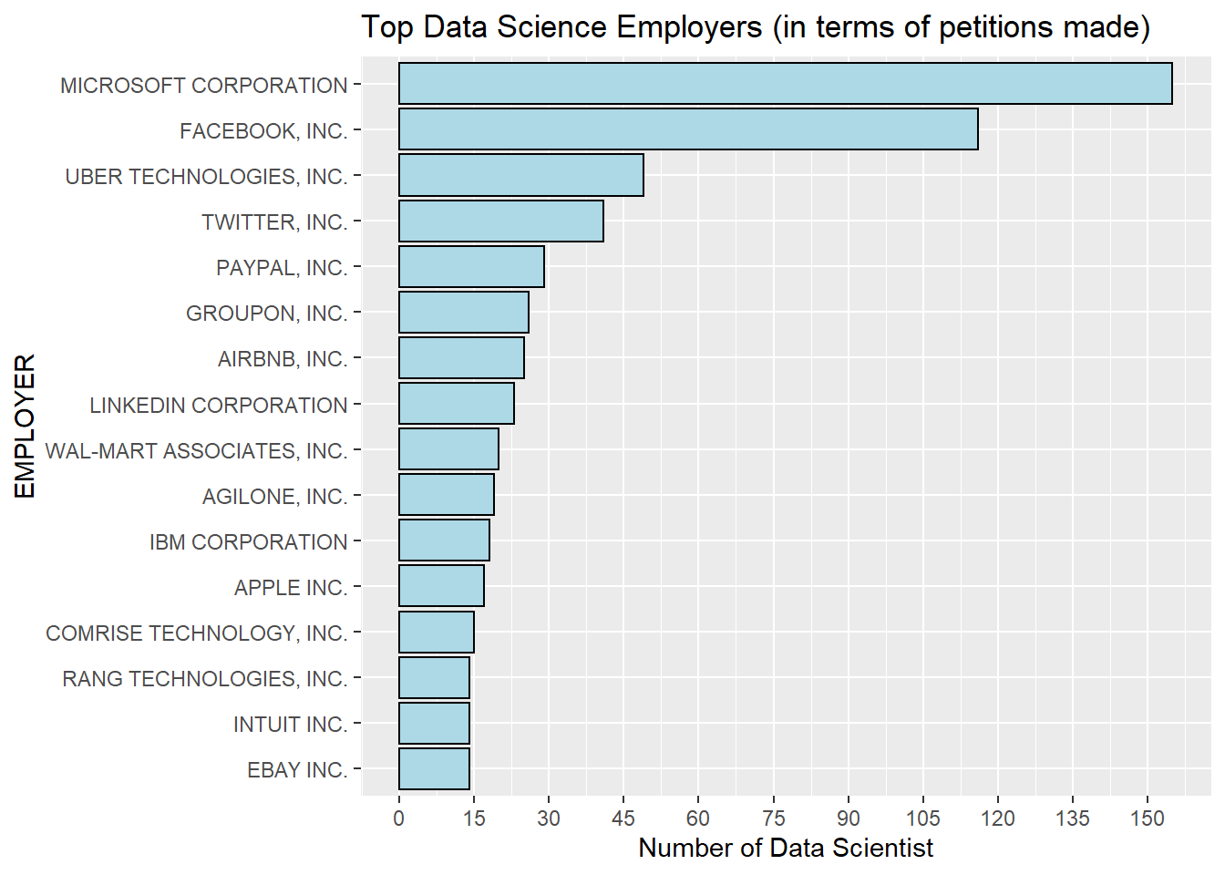
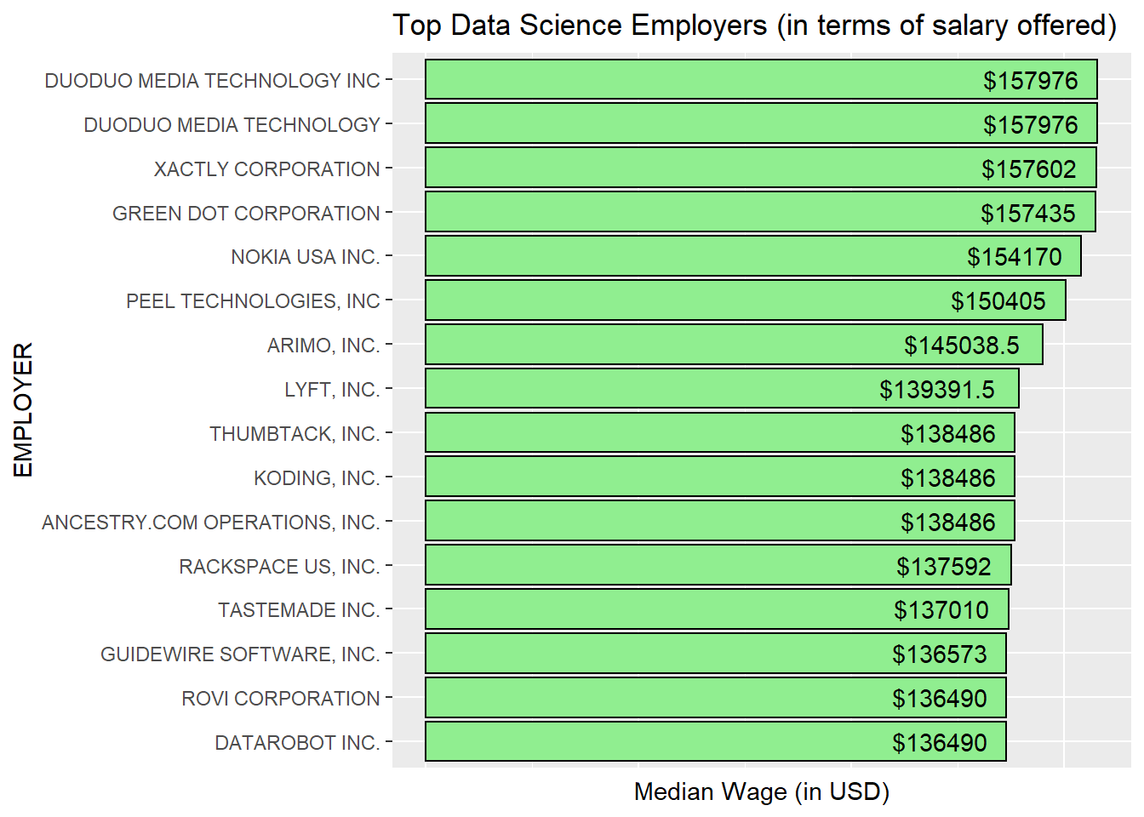
Data Exploration (cont'd)
Continuing further with the various scenarios of H1-B petition status under Data Scientist role.
Following observations were made:
A
b

Slide 12
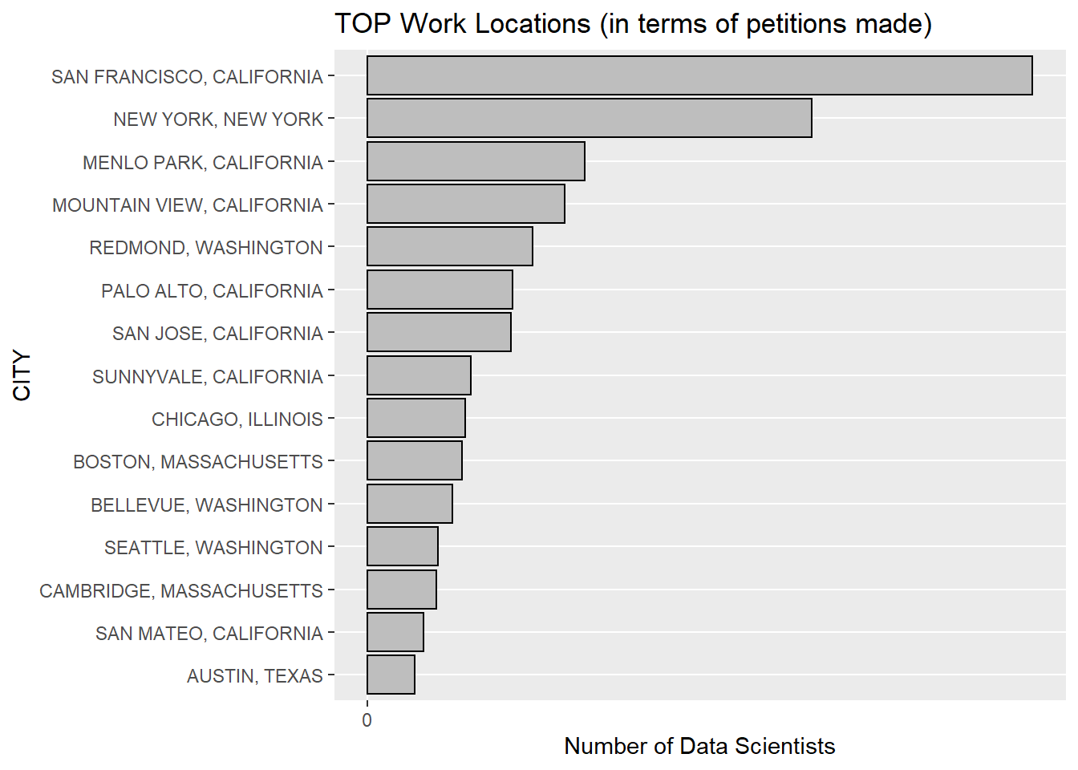
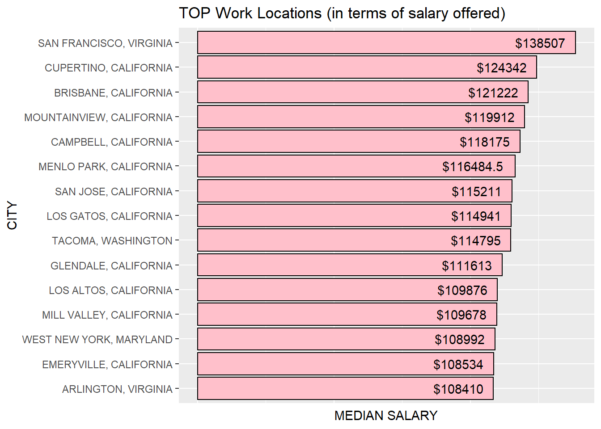
Data Exploration (cont'd)
Even more exploration!

Slide 13
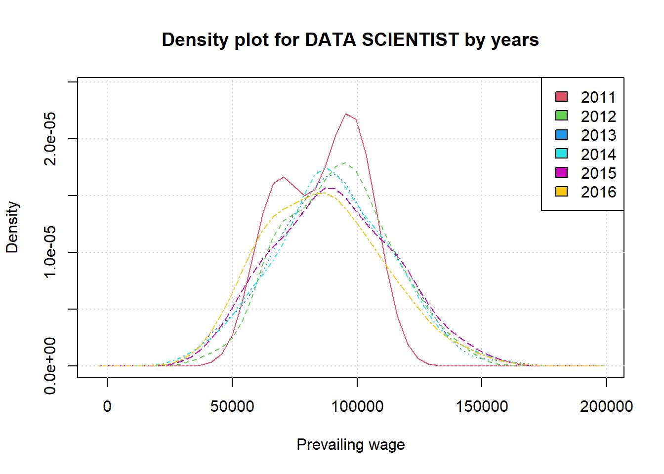
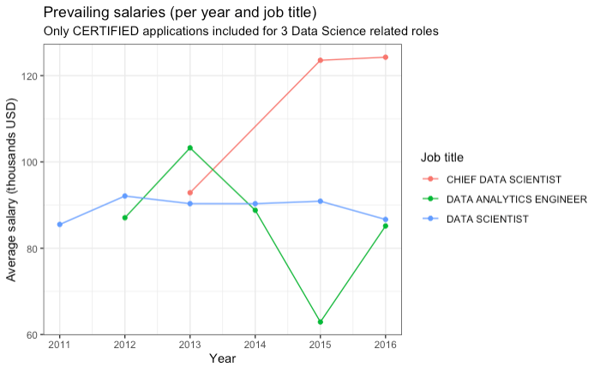
Data Exploration (cont'd)
Some More...

Slide 14
Observations from the previous graphs
Microsoft and Facebook are way ahead in filing petitions for Data Scientist jobs.On the other hand some not so familiar companies are paying the highest salariesin the field.
The average salary reported on an H1B application for last 5 years was around 89kUSD for Data Science related jobs. The figure (salary Distribution) tells 25%above than the average salary reported for H1B application for overall jobs
The median salary stays around USD 90k with a little decrease over the years. Butit is still around USD 90k. However, a clear upward trend can be seen in numberof petitions made each year.
For 2011 there is an interesting double peak density plot profile, with highest peakat USD 95k and lower peak at USD 65k. The values span is increasing in 2012 with alonger queue to the upper values, up to USD 150k and above (also) and follow almostthe same profile until 2016. The prevailing wages interval increased although theaverages values did not moved drastically from the initial average.
We can observe that DATA SCIENTIST shows quite a constant variation duringthe period 2011-2016, with peak value for 2012

Slide 15
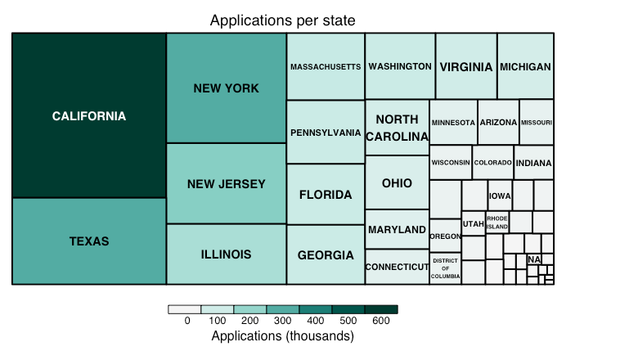
State-wise applications
The States with most of the Applications are
California
Texas
New York
New Jersey
Illinois.

Slide 16
Predicting The Petitions
To predict the outcome of a H1B visa petitions, several models have been constructed using different methodologies.
A model is a physical, mathematical or logical representation of a system or process, which develops data as a basis for managerial or technical decision making.
For this system, we have used 3 methods of model design, which are:
Logistic Regression
Gradient Boosting
Random Forest

Slide 17
General Overview
Getting useful information from raw data is next to impossible. Hence, it is essential to understand the objective of the model before aimlessly running some sort of analysis.
Before building the model, it is essential to explore the data. Every variable must be scrutinized.
Only keep those values where the case status is either accepted or denied. Filter out the rest.
Divide the data into two groups, one of which is used for training and the other is used for testing.
Implement the model and fit it to the training sample. Use the testing sample to make predictions on whether or not a visa petition will be CERTIFIED or DENIED and check performance measures, i.e., how well the model is able to predict results.

Slide 18
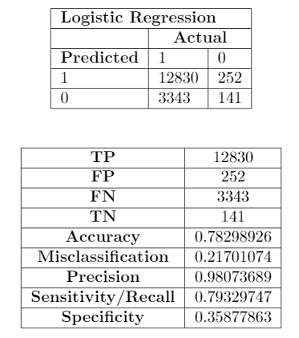
Logistic Regression
This is a very simple classification technique.
It uses regression of independent variables against a single response variable to predict the response variable.
On viewing the results, it is seen that the accuracy is stunningly poor. The reasons for this could be any of the following.
High likelihood of overfitting in high dimensional data
Given that this data is not linearly separable, getting a highly accurate model is impossible.
Too difficult to obtain complex relationships in data. There are much more powerful algorithms and tools.
The confusion matrix and subsequent metrics calcuted:

Slide 19
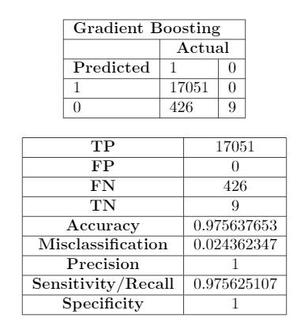
Gradient Boosting
Boosting is an ensemble method which uses multiple trees to get the final prediction.
GBM (Gradient Boosting Method) is unique compared to other decision tree algorithms because it builds up a strong predicting model by initially starting with extremely weak predictors and then learning from their errors.
The tree in this method is run and the observations where performance is poor are noted. Then these observations are given extra weight so that future weak learners can focus on these.
Each tree in the model is given a certain weight and eventually trees are combined together.
GBM is an efficient and powerful algorithm for classification and regression problems.
Here, we see a significantly improved accuracy of 97%. GBM is extremely flexible and highly accurate, however, it is computationally expensive.
The confusion matrix and subsequent metrics calcuted:

Slide 20
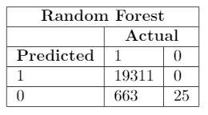
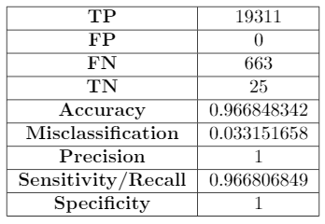
Random Forest Model
We did some further preprocessing on the data.
We introduced a system of taking 'n' random datapoints from the dataset, otherwise we were running out of RAM (since the dataset has more than 2.6 million datapoints)
We dropped the features CITY, latitude and longitude but we kept the feature STATE as they all describe the location.
We used one hot encoding for the features FULL_TIME_POSITION and YEAR for better training.
We used Label Encoder for STATE as using one hot encoder would create too many features.
There are three other features which are categorical and have very high cardinality: EMPLOYER_NAME, SOC_NAME, JOB_TITLE
First, we tried by Label Encoding them and trained our model but didn't get a good enough result.
Then we dropped these features and got decent results.
We used 80% of the dataset for training and the rest for testing.
The confusion matrix and subsequent metrics calcuted:

Slide 21
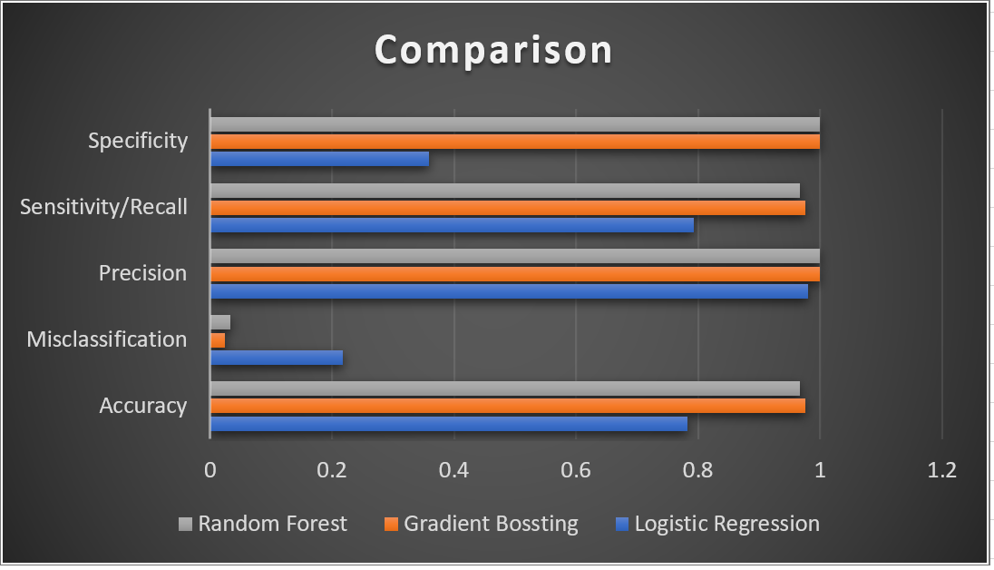
Conclusion
Based on the previous three models, we achieved best accuracy with Random Forests.
However, the target value which is being classified is not evenly distributed.
We have a lot more values of CERTIFIED compared to DENIED.
If we had more datapoints with the DENIED label, our results would have been even better.

Slide 22
THANK YOU

